Slide 1
Module 5
XML

Slide 2
SYLLABUS
Syntax of XML
XML Document Structure
Namespaces
XML Schemas
Displaying Raw XML Documents
Displaying XML Documents with CSS
XSLT Style Sheets
XML Applications

Slide 3
Standard Generalized Markup Language (SGML)
In 1986 an international standard for markup languages came into existence called Standard Generalized Markup Language
XML is a subset of SGML intended to make SGML light enough for use on the web
XML is a proper subset of SGML
SGML
XML

Slide 4
XML was designed to be the simplified version of SGML.
Allow users to define their own markup languages.
HTML
markup language that is meant to describe the layout of general information
provide some guidance as to how it should be displayed
XML
Metamarkup language that provides a framework for defining specialized markup languages
XHTML is an XML-based version of HTML.

Slide 5
DIFFERENCE BETWEEN XML AND HTML
XML was designed to carry data with focus on what data is.
HTML was designed to display data with focus on how data looks.
HTML use predefined tags.
XML does not use predefined tags. It can use userdefined tags.

Slide 6
Introduction to XML
XML is a software and hardware independent tool for storing and transporting data.
XML stands for eXtensible Markup Language
XML is a markup language much like HTML
XML was designed to store and transport data
XML was designed to be self-descriptive
XML is a W3C Recommendation
XML is just information wrapped in tags.

Slide 7
Advantages of XML
It simplifies data sharing
It simplifies data transport
It simplifies platform changes
It simplifies data availability

Slide 8
EXAMPLE
<note> <date>2015-09-01</date> <hour>08:30</hour> <to>Tove</to> <from>Jani</from> <body>Hello</body> </note>
Ref: https://www.w3schools.com/xml/xml_whatis.asp

Slide 9
1. SYNTAX
XML documents must contain one root element that is the parent of all other elements.
<root> <child> <subchild>.....</subchild> </child> </root>
Here note is a root tag and the remaining are child tags.

Slide 10
Syntax Rules
<?xml version="1.0" encoding="UTF-8"?> <note> <to>Tove</to> <from>Jani</from> <heading>Reminder</heading> <body>Don't forget me this weekend!</body> </note>
The first line is the XML Prolog.(Red line)
The XML prolog is optional. If it exists, it must come first in the document.
To avoid errors, always specify the encoding used, or save your XML files as UTF-8.
UTF-8 is the default character encoding for XML documents.

Slide 11
The root element is <note>
XML tags are case sensitive.
All XML elements must have a closing tag.
XML Attribute Values Must Always be Quoted
<note date="12/11/2007"> <to>Tove</to> <from>Jani</from> </note>

Slide 12
Entity References
If you place a character like "<" inside an XML element, it will generate an error because the parser interprets it as the start of a new element.
<message>salary < 1000</message>
This will generate an XML error:
To avoid this error, replace the "<" character with an entity reference:
<message>salary &lt; 1000</message>

Slide 13
There are 5 pre-defined entity references in XML:
&lt; | < | Less than
&gt; | > | Greater than
&amp; | & | Ampersand
&apos; | ‘ | Apostrophe
&quot; | “ | Quotation mark

Slide 14
Comments in XML are the same as in HTML.
<!-- This is a comment -->
XML names are used to name elements and attributes.
XML name must begin with a letter or an underscore and can include digits, hyphens, and periods.
XML names are case sensitive
no length limitation for XML names

Slide 15
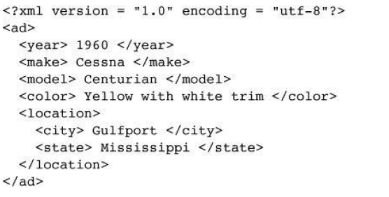
An XML document example:

Slide 16
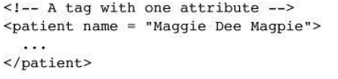
A nested element should be used if the data is subdata of the parent element’s content
Attributes are used to specify the information about the element.
Three possible choices between tags and attributes:

Slide 17
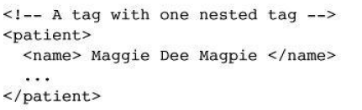
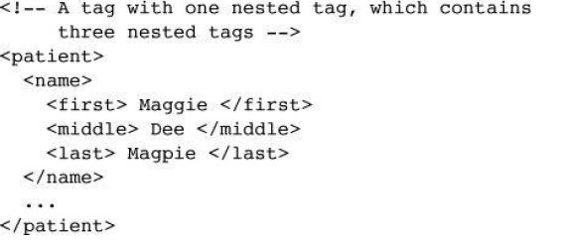

Slide 18
2. XML Namespaces
XML Namespaces provide a method to avoid element name conflicts.
In XML, element names are defined by the developer.
This often results in a conflict when trying to mix XML documents from different XML applications.
The following XML carries table with rows and columns
<table> <tr> <td>Apples</td> <td>Bananas</td> </tr> </table>

Slide 19
This XML carries information about a table (a piece of furniture)
<table> <name>African Coffee Table</name> <width>80</width> <length>120</length> </table>
If these XML fragments were added together, there would be a name conflict. Both contain a <table> element, but the elements have different content and meaning.
A user or an XML application will not know how to handle these differences.

Slide 20
SOLUTION TO NAMECONFICTS
Solving the Name Conflict Using a Prefix
<h:table> <h:tr> <h:td>Apples</h:td> <h:td>Bananas</h:td> </h:tr> </h:table> <f:table> <f:name>African Coffee Table</f:name> <f:width>80</f:width> <f:length>120</f:length> </f:table>
In the example above, there will be no conflict because the two <table> elements have different names.

Slide 21
XML Namespaces - The xmlns Attribute
When using prefixes in XML, a namespace for the prefix must be defined.
The namespace can be defined by an xmlns attribute in the start tag of an element.
The namespace declaration has the following syntax.
xmlns:prefix="URI".
The namespace URI is not used by the parser to look up information.
The purpose of using an URI is to give the namespace a unique name.

Slide 22
EXAMPLE
<root> <h:table xmlns:h="http://www.w3.org/TR/html4/"> <h:tr> <h:td>Apples</h:td> <h:td>Bananas</h:td> </h:tr> </h:table> <f:table xmlns:f="https://www.w3schools.com/furniture"> <f:name>African Coffee Table</f:name> <f:width>80</f:width> <f:length>120</f:length> </f:table> </root>

Slide 23
In the example above:
The xmlns attribute in the first <table> element gives the h: prefix a qualified namespace.
The xmlns attribute in the second <table> element gives the f: prefix a qualified namespace.
When a namespace is defined for an element, all child elements with the same prefix are associated with the same namespace.
Namespaces can also be declared in the XML root element.

Slide 24
3. XML Document Structure
An XML document often uses two auxiliary files:
One that defines its tag set and structural syntactic rules
One that contains a style sheet to describe how the content of the document is to be printed or displayed.
The structural syntactic rules are given as either a DTD or an XML schema.
Two approaches to style specification are using CSS and eXtensible Stylesheet Language (XSL)

Slide 25
Document is breakdown into multiple logically related collections of information- entities.
Document entity- it includes references to the names of entities that are stored elsewhere
Every entity except the document entity must have a name.
XML processor encounters the name of a nonbinary entity in a document, it replaces the name with the value it references.

Slide 26
Entity names can be any length.
Must begin with a letter, a dash, or a colon
After the first character, a name can have letters, digits, periods, dashes,underscores, or colons.
A reference to an entity is its name together with a prepended ampersand and an appended semicolon.
&apple_image;

Slide 27
Character data section
The content of a character data section is not parsed by the XML parser- any tags it may include are not recognized as tags.
The form of a character data section is:
<![CDATA[ content ]]>
For example, instead of
The last word of the line is &gt;&gt;&gt; here &lt;&lt;&lt;
the following could be used:
<![CDATA[The last word of the line is >>> here <<<]]>

Slide 28
4. Document Type Definitions(DTD)
DTD is a set of structural rules called declarations
specify a set of elements and attributes that can appear in a document, as well as how and where these elements and attributes may appear.
DTDs also provide entity definitions.
DTDs are used when the same tag set definition is used by a collection of documents

Slide 29
An XML document with correct syntax is called "Well Formed".
An XML document validated against a DTD is both "Well Formed" and "Valid".
DTD stands for Document Type Definition.
A DTD defines the structure and the legal elements and attributes of an XML document.
<?xml version="1.0" encoding="UTF-8"?> <!DOCTYPE note SYSTEM "Note.dtd"> <note> <to>Tove</to> <from>Jani</from> <heading>Reminder</heading> <body>Don't forget me this weekend!</body> </note>
The DOCTYPE declaration above contains a reference to a DTD file. The content of the DTD file is shown and explained below.

Slide 30
Note.dtd:
<!DOCTYPE note [ <!ELEMENT note (to,from,heading,body)> <!ELEMENT to (#PCDATA)> <!ELEMENT from (#PCDATA)> <!ELEMENT heading (#PCDATA)> <!ELEMENT body (#PCDATA)> ]>
The DTD above is interpreted like this:
!DOCTYPE note - Defines that the root element of the document is note
!ELEMENT note - Defines that the note element must contain the elements: "to, from, heading, body"
!ELEMENT to - Defines the to element to be of type "#PCDATA"
!ELEMENT from - Defines the from element to be of type "#PCDATA"
!ELEMENT heading - Defines the heading element to be of type "#PCDATA"
!ELEMENT body - Defines the body element to be of type "#PCDATA

Slide 31
Internal DTD
A DTD is embedded in the XML document whose syntax rules it describes.
External DTD
DTD stored in a separate file

Slide 32
DTD is a sequence of declarations, each of which has the form of a markup declaration:
<!keyword ... >
Four possible keywords
ELEMENT, used to define tags
ATTLIST, used to define tag attributes
ENTITY, used to define entities
NOTATION, used to define data type notations.

Slide 33
4.1 Declaring Elements
element declaration in a DTD specifies the structure of one category of elements.
declaration provides the name of the element along with the specification of the structure of that element.
The form of an element declaration:
<!ELEMENT element_name (list of names of child elements)>

Slide 34
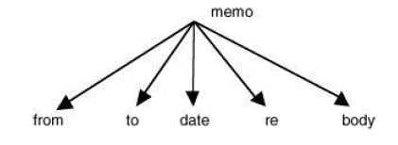
For example, consider the following declaration:
<!ELEMENT memo (from, to, date, re, body)>
Document tree structure will be

Slide 35
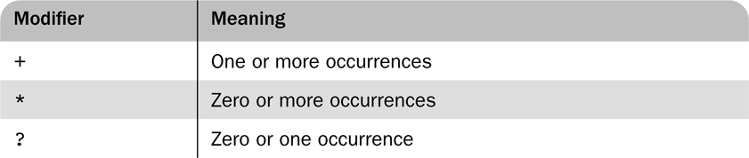
it is necessary to specify the number of times that a child element may appear.
can be done in a DTD declaration by adding a modifier to the child element specification.
Child element specification modifiers
<!ELEMENT person (parent+, age, spouse?, sibling*)>
One or more parent, one age, possibly a spouse element, and zero or more sibling elements

Slide 36
The leaf nodes of a DTD specify the data types of the content of their parent nodes
the content of an element is type PCDATA, for parsable character data
Parsable character data is a string of any printable characters except “less than” (<), “greater than” (>), and the ampersand (&).
Two other content types can be specified: EMPTY and ANY.
The EMPTY type specifies that the element has no content
The ANY type is used when the element may contain literally any content
<!ELEMENT element_name (#PCDATA)>

Slide 37
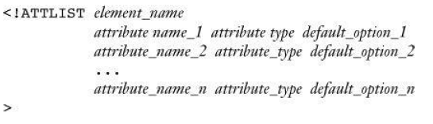
4.2 Declaring Attributes
An attribute declaration must include the name of the element to which the attribute belongs, the attribute’s name, its type, and a default option.
general form of an attribute declaration:
<!ATTLIST element_name attribute_name attribute type default_option>
If more than one attribute is declared for a given element

Slide 38
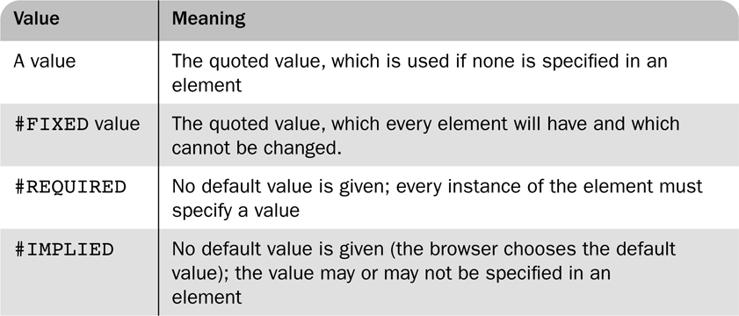
There are 10 different attribute types.
CDATA is commonly used
default option in an attribute declaration can specify either an actual value or a requirement for the value of the attribute
Possible default options for attributes

Slide 39
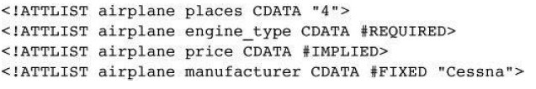
For example, suppose the DTD included the following attribute specifications:
Then the following XML element would be valid for this DTD:
<airplane places = “10” engine_type = “jet”> </airplane>

Slide 40
4.3 Declaring Entities
Entities defined so that they can be referenced anywhere in the content of an XML document- general entities.
Predefined entities are all general entities.
Entities defined so that they can be referenced only in DTDs- parameter entities
The form of an entity declaration is
<!ENTITY [%] entity_name “entity_value”>
the optional percent sign (%) is present in an entity declaration- specifies that the entity is a parameter entity

Slide 41
example of an entity
<!ENTITY mace “Mar Athanasius College of Engineering ”>
Any XML document that uses a DTD that includes this declaration can specify the complete name with just the reference &mace;.
When an entity is longer than a few words, its text is defined outside the DTD- external text entity
The form of the declaration of an external text entity is
<!ENTITY entity_name SYSTEM “file_location”>
The keyword SYSTEM specifies that the definition of the entity is in a different file, which is specified as the string following SYSTEM.

Slide 42
XML parsers check documents that have DTDs in order to ensure that the documents conform to the structure specified in the DTDs
These parsers are called validating parsers.
Validating XML parsers detect and report all inconsistencies in documents relative to their DTDs.

Slide 43
4.4 Internal and External DTDs
Internal DTD
the DTD is included in the XML code, it must be introduced with
<!DOCTYPE root_name [ and terminated with ]>
Eg:
<? xml version=“1.0” encoding=“utf-8”?>
<!DOCTYPE planes_for_sale [
<!-- DTD for Planes-- >
]>
<!-- Xml document for planes-- >

Slide 44
Extrenal DTD
the DTD is in a separate file
declaration has the following form:
<!DOCTYPE XML_document_root_name SYSTEM “DTD_file_name”>
Eg: assuming that the DTD is stored in the file named planes.dtd
<!DOCTYPE planes_for_sale SYSTEM planes.dtd”>

Slide 45
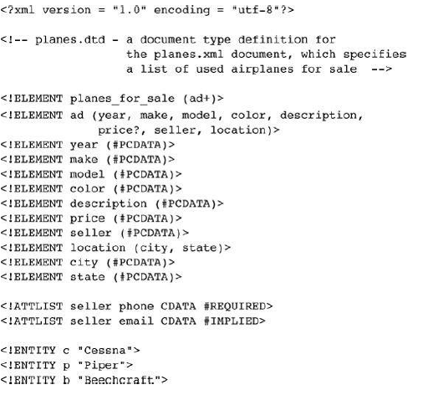

Slide 46
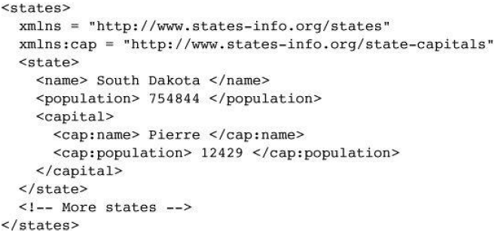

Slide 47
5 XML Schemas
DTDs have several disadvantages
DTDs are written in a syntax unrelated to XML.
DTDs do not allow restrictions on the form of data that can be the content of a particular tag.
there are only 10 data types, none of which is numeric.
the content of an element could be an integer number, a floating-point number, or a range of numbers. All of these would be specified as text

Slide 48
XML Schema standard was designed by the W3C
have been developed to attempt to overcome the weakness of DTD
An XML schema is an XML document- can be parsed with an XML parser
provides far more control over data types
There are 44 different data types
Also, the user can define new types with constraints on existing data types.
Eg: a numeric data value can be required to have exactly seven digits.
XML Schema was designed to allow any DTD to be automatically converted to an equivalent XML schema.

Slide 49
5.1 Schema Fundamentals
Schemas can be related to the idea of a class and an object.
A schema is similar to a class definition;
A schema is similar to a class definition; an XML document that conforms to the structure defined in the schema is similar to an object of the schema’s class
Schemas have two primary purposes
schema specifies the structure of its instance XML documents
a schema specifies the data type of every element and attribute in its instance XML documents.

Slide 50
XML schemas are “namespace centric.”
namespaces are represented by names that have the form of URIs.

Slide 51
5.2 Defining a Schema
Schemas themselves are written with the use of a collection of tags, or a vocabulary, from a namespace
The namespace used is http://www.w3.org/2001/XMLSchema.
the elements in the namespace are
element,
schema,
sequence, and
string.

Slide 52
Every schema has schema as its root element.
schema element specifies the namespace for the schema of schemas
also specifies a prefix that will be used for the names in the schema.
namespace specification appears as follows:
xmlns:xsd = http://www.w3.org/2001/XMLSchema

Slide 53
The name of the namespace defined by a schema must be specified with the targetNamespace attribute of the schema element.
The name of every top-level (not nested) element that appears in a schema is placed in the target namespace
targetNamespace = http://cs.uccs.edu/planeSchema
If the elements and attributes are nested inside top-level elements are to be included in the target namespace- schema’s elementFormDefault must be set to qualified
elementFormDefault = “qualified”

Slide 54
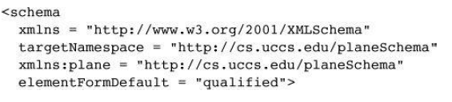
Schema definition example:

Slide 55
5.3 Defining a Schema Instance
An instance of a schema must include specifications of the namespaces it uses.
These specifications are given as attribute assignments in the tag for the root element of the schema.
First attribute specifies default namespace to be the one defined in its schema
<planes
xmlns = http://cs.uccs.edu/planeSchema
... >

Slide 56
second attribute is used to name the standard namespace for instances- includes the name XMLSchema-instance.
xmlns:xsi = http://www.w3.org/2001/XMLSchema-instance
Third, the instance document must specify the filename of the schema in which the default namespace is defined
schemaLocation attribute is used
two values: the namespace of the schema and the filename of the schema.

Slide 57
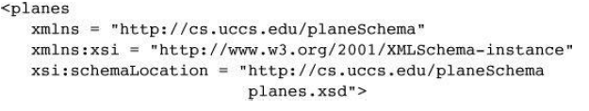
the opening root tag of an XML instance of the planes.xsd schema, where the root element name in the instance is planes

Slide 58
5.4 An Overview of Data Types
two categories of user-defined schema data types: simple and complex.
A simple data type is a data type whose content is restricted to strings
A simple type cannot have attributes or include nested elements.
a large collection of predefined data types is included in the category.
A complex type can have attributes and include other data types as child elements.

Slide 59
The XML Schema defines 44 data types, 19 of which are primitive and 25 of which are derived.
The primitive data types include
string, Boolean, float, time, and anyURI.
The predefined derived types include byte, long, decimal, unsignedInt, positiveInteger, and NMTOKEN
User-defined data types are defined by specifying restrictions on an existing type
Then existing data type are called a base type and user-defined types are derived types

Slide 60
Constraints on derived types are given in terms of the facets of the base type.
Eg:
the integer primitive data type has eight possible facets: totalDigits, maxInclusive, maxExclusive, minInclusive, minExclusive, pattern, enumeration, and whitespace
Both simple and complex types can be named or anonymous.
If anonymous, a type cannot be used outside the element in which it is declared.
context is essential to defining the meaning of a reference to an element in an XML schema.

Slide 61
Data declarations in an XML schema can be either local or global
A local declaration is a declaration that appears inside an element that is a child of the schema element (a declaration in a grandchild element of schema)
A locally declared element is visible only in that element.
A global declaration is a declaration that appears as a child of the schema element.
Global elements are visible in the whole schema in which they are declared

Slide 62
5.5 Simple Types
Elements are defined in an XML schema with the element tag, which is from the XMLSchema namespace
prefix xsd is normally used for names from this namespace
name attribute gives the name of element
Type attribute, which is used to specify the type of content allowed in the element
<xsd:element name = “engine” type = “xsd:string” />

Slide 63

An instance of the schema in which the engine element is defined could have the following element:
<engine> inline six cylinder fuel injected </engine>
An element can be given a default value with the default attribute:

Slide 64
Elements can have constant values defined using fixed attribute

Slide 65
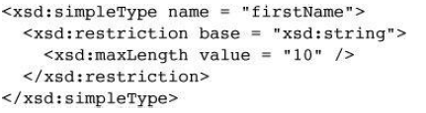
A simple user-defined data type is described in a simpleType element
Facets must be specified in the content of a restriction element, which gives the base type name.
The facets themselves are given in elements named for the facets: the value attribute specifies the value of the facet.
user-defined type, firstName, for strings of fewer than 11 characters:

Slide 66
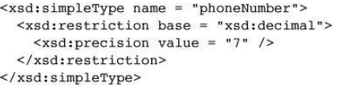
length facet is used to restrict the string to an exact number of characters
minLength facet is used to specify a minimum length
The number of digits of a decimal number can be restricted with the precision facet

Slide 67
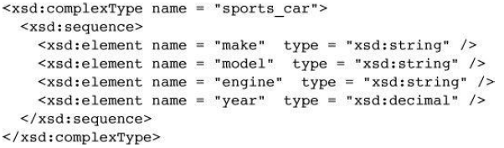
5.6 Complex Types
defined with the complexType tag
The elements that are the content of an element-only element must be contained in an ordered group, an unordered group, a choice, or a named group.
The sequence element is used to contain an ordered group of elements

Slide 68
A complex type whose elements are an unordered group is defined in an all element.

Slide 69
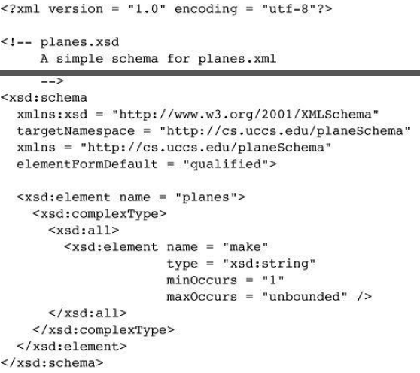
Example -xml schema

Slide 70
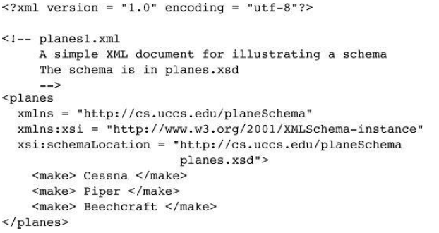
Xml document:

Slide 71
5.7 Validating Instances of Schemas
several XML schema validation tools are available.
One of them is named xsv( XML Schema Validator).
The output of xsv is an XML document.

Slide 72
6. Displaying Raw XML Documents
style sheet defines presentation styles for the document’s tags
if an XML document is displayed without a style sheet, document will not have formatted content.
Contemporary browsers include default style sheets- used when no style sheet is specified in the XML document.
The display of such an XML document is only a document tree( somewhat stylized listing of the XML markup).

Slide 73
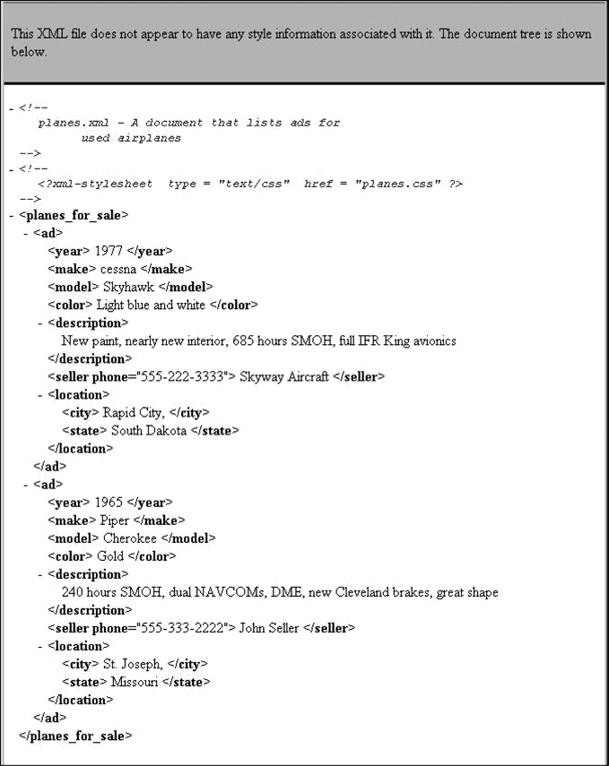
A display of an XML document with the FX3 default style sheet

Slide 74
7. Displaying XML Documents with CSS
Style-sheet information can be provided to the browser for an XML document in two ways
Cascading Style Sheet (CSS)
XSLT style-sheet
using CSS is effective,
XSLT provides far more power over the appearance of the document’s display.

Slide 75
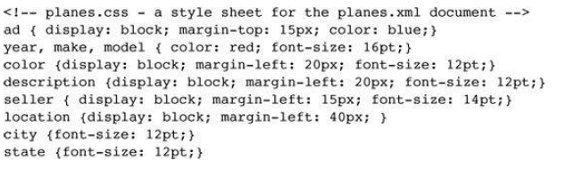
CSS style sheet for an XML document is simple.
It is a list of element names, each followed by a brace-delimited set of attributes.
Example:

Slide 76
Display property- used to specify whether an element is to be displayed inline or in a separate block.
two options are specified with the values inline and block.
The inline value is the default
When display is set to block, the content of the element is usually separated from its sibling elements by line breaks.

Slide 77
The connection of an XML document to a CSS style sheet is established with the processing instruction xml-stylesheet
Two attributes
type: specifies the particular type of the style sheet
href: name of the file that stores the style sheet
<?xml-stylesheet type = “text/css” href = “planes.css” ?>

Slide 78
8. XSLT Style Sheets
eXtensible Stylesheet Language (XSL) is a family of recommendations for defining the presentation and transformations of XML documents.
XSLT (eXtensible Stylesheet Language Transformations) is the recommended style sheet language for XML.
XSLT is far more sophisticated than CSS. With XSLT we can add/remove elements and attributes to or from the output file.
It is possible to rearrange and sort elements, perform tests and make decisions about which elements to hide and display, and a lot more.
XSLT uses XPath to find information in an XML document.
Consists of three related standards:
XSL Transformations (XSLT),
XML Path Language (XPath),
XSL Formatting Objects (XSL-FO)

Slide 79
XSLT style sheets are used to transform XML documents into different forms or formats
XSLT transforms XML documents into XHTML documents, primarily for display
XPath is a language for expressions
used to identify parts of XML documents

Slide 80
8.1 Overview of XSLT
XSLT : simple functional-style programming language
XSLT includes functions, parameters, names to which values can be bound, selection constructs, and conditional expressions for multiple selection.
The syntactic structure of XSLT is XML

Slide 81
The transformation process used by an XSLT processor
XSLT processors take both an XML document and an XSLT document as input.
XSLT document is the program to be executed
XML document is the input data to the program.
Parts of the XML document are selected, possibly modified, and merged with parts of the XSLT document to form a new document, ie, XSL document

Slide 82
XSL document is also an XML document
XSL document could be again the input to an XSLT processor
The output document can be stored for future use by applications, or it may be immediately displayed by an application
Neither the XSLT document nor the input XML document is changed by the XSLT processor.

Slide 83
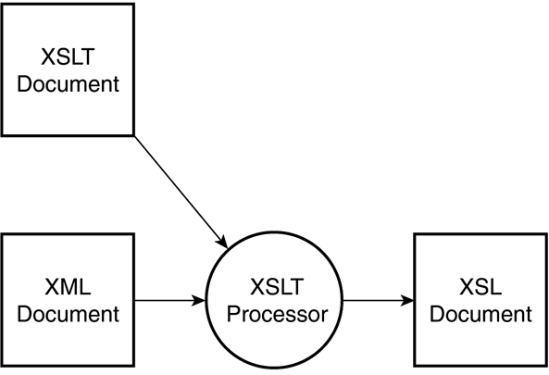
XSLT processing

Slide 84
XSLT document consists primarily of one or more templates
It uses XPath to describe element–attribute patterns in the input XML document
each template describes a function that is executed whenever the XSLT processor finds a match to the template’s pattern.
XSLT processor sequentially examines the input XML document
searching for parts that match one of the templates in the XSLT document.

Slide 85
XSLT model of processing XML data
template-driven model: highly regular data collections, files containing records.
data-driven model: irregular and recursive data, using template fragments

Slide 86
8.2 XSL Transformations for Presentation
XSLT style-sheet document is included into an xml document using the following processing instruction

Slide 87
XML
<?xml version="1.0" encoding="UTF-8"?> <breakfast_menu> <food> <name>Belgian Waffles</name> <price>$5.95</price> <description>Two of our famous Belgian Waffles with plenty of real maple syrup</description> <calories>650</calories> </food> <food> <name>Strawberry Belgian Waffles</name> <price>$7.95</price> <description>Light Belgian waffles covered with strawberries and whipped cream</description> <calories>900</calories> </food> <food> <name>Berry-Berry Belgian Waffles</name> <price>$8.95</price> <description>Light Belgian waffles covered with an assortment of fresh berries and whipped cream</description> <calories>900</calories> </food> <food> <name>French Toast</name> <price>$4.50</price> <description>Thick slices made from our homemade sourdough bread</description> <calories>600</calories> </food> <food> <name>Homestyle Breakfast</name> <price>$6.95</price> <description>Two eggs, bacon or sausage, toast, and our ever-popular hash browns</description> <calories>950</calories> </food> </breakfast_menu>

Slide 88
Use XSLT to transform XML into HTML, before it is displayed in a browser.
<?xml version="1.0" encoding="UTF-8"?> <html xsl:version="1.0" xmlns:xsl="http://www.w3.org/1999/XSL/Transform"> <body style="font-family:Arial;font-size:12pt;background-color:#EEEEEE"> <xsl:for-each select="breakfast_menu/food"> <div style="background-color:teal;color:white;padding:4px"> <span style="font-weight:bold"><xsl:value-of select="name"/> - </span> <xsl:value-of select="price"/> </div> <div style="margin-left:20px;margin-bottom:1em;font-size:10pt"> <p> <xsl:value-of select="description"/> <span style="font-style:italic"> (<xsl:value-of select="calories"/> calories per serving)</span> </p> </div> </xsl:for-each> </body> </html>

Slide 89
REFERENCES
https://www.w3schools.com/xml

